Slide 1
“A Vision of an Ideal World” in a Chinese Poetry: “Peach Blossom Spring” 桃花源
By Dr. Ling-Ling Shih

Slide 2
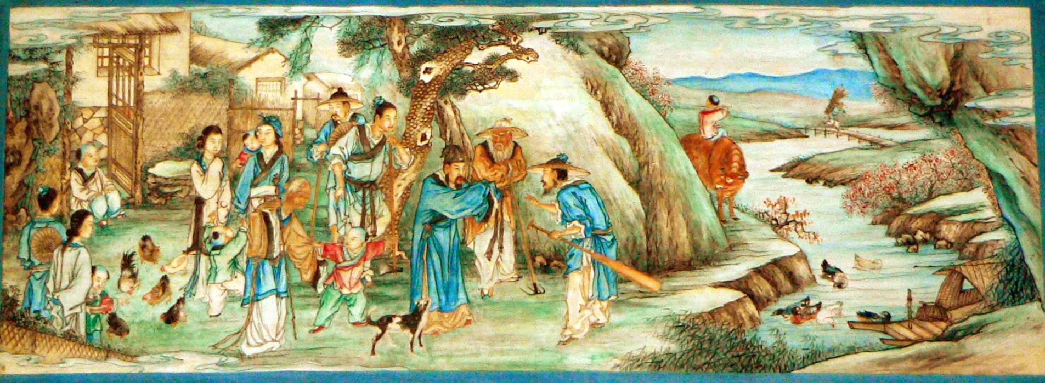
FFW: Describe what you see in this Chinese painting. Write two sentences to describe what kind of society/community the painter tries to depict? And share on the chat box (5 min.) This painting is drawn by a painter based on his interpretation of the ancient prose we are going to read. (Click here for the source of this painting)

Slide 3
Background info about “Peach Bloom Spring written by Tao Qian
Introduction Tao Qian (T’ao Ch’ien, or Tao Yuanming, 376-427 CE) was a man of the southern part of China during 317-479 AD, during the period in which China was divided between northern and southern dynasties. The years before and during his time were characterized by warfare and instability. The country was divided into two parts. The rulers and elite of the south were tortured by the loss of the north to various non-Chinese (mostly Turkic) rulers. In both north and south, one ruling house succeeded another. It was in this context of instability that Tao Qian, an official, scholar, and poet, wrote his famous essay, “Peach Blossom Spring.”
From: http://afe.easia.columbia.edu/ps/china/taoqian_peachblossom.pdf

Slide 4
“Peach Bloom Spring “
Read the article: lick to access taoqian_peachblossom.pdf
Read the article silently on your own (10 min.)
  Please annotate while your read this article.
    Underline phrases and sentences that you find significant.
    Circle words you find interesting or surprising.
    Put a question mark on words, phrases, or sentences you find confusing or not understandable.

Slide 5
Read out loud as a class (5 min.)
Take turn to read out loud. Each student read one sentence. To keep it going, I will call your name, and you read.
Please take more annotations as you read. And mark on the words, phrases and sentences that you find significant or confusing.

Slide 6
Watch a version of an animation based on this Ancient Chinese Prose (15 min.)
https://www.youtube.com/watch?v=4Ik7zoq-r_g
(With English subtitles)

Slide 7
Answer the following questions: 10 min group discussion, 10 min. sharing
Divide into five groups; each group is assigned a question to discuss.
Group 1 FFW:
What does this narrative essay reveal about the author’s state of mind?
Group 2 FFW: Are there any parallels to this essay in other cultures or American history?
Group 3 FFW: In what historical periods of world history do you think men would be most likely to identify with the author?
Group 4 FFW: What is the ideal world this author is yearning for?
Group 5 FFW: Compare it with John Lennon’s imagined world in his song “Imagine.” You can also compare it with M. Jackson’s song (Man in the Mirror. Point to similarities and differences of these two idealized worlds.
Each group should have one student sum up their main points in their discussion. (2 min for each group)

